Slide 1
UPPER SIXTH ARTS
GEOGRAPHY
Lesson 2
Site and Situation of Settlements
Notes:
Good morning, class, and welcome to our geography lesson. I am your geography teacher, Mr Kamdem. Today we are starting Lesson 2: Site and Situation of Settlements.

Slide 2
CLASS INFO
Class, Chapter and Duration
Class | Upper Sixth Arts
Chapter | Module 5: Understanding and managing settlement dynamics across the world in general and Cameroon in particular
Duration | 2 periods (2 × 50 minutes)
Notes:
This lesson is for Upper Sixth Arts. It belongs to Module 5: Understanding and managing settlement dynamics across the world in general and Cameroon in particular. We shall need 2 periods to cover it.

Slide 3
IDENTIFICATION
Lesson Identification
Topic | Location of Settlement
Sub-topic | Location of Settlement
Lesson | Lesson 2: Site and Situation of Settlements
Notions / Concepts | Site, situation, wet point, dry point, defensive site, bridging point, gap town, confluence.
Syllabus focus | Site and situation; types of site with examples; factors of site.
Competence | Learners are able to describe the site and situation of a settlement.
Notes:
Our topic is Location of Settlement, and the sub-topic is Location of Settlement. The key notions we shall use today are: site, situation, wet point, dry point, defensive site, bridging point, gap town, confluence. At the end, you should be able to do this: learners are able to describe the site and situation of a settlement.

Slide 4

HOMEWORK CORRECTION
Correction of the Homework
Question (Lesson 1: Settlement: Meaning, Evolution and Early Location):
Ask an old person why your village was founded where it is.
Notes:
Before we start the new lesson, let us correct the homework I gave you at the end of Lesson 1: Settlement: Meaning, Evolution and Early Location. The question was: Ask an old person why your village was founded where it is. Take out your exercise books.

Slide 5
HOMEWORK CORRECTION
Correction: Possible Answer
Example: the elder explained that the village was founded near a permanent spring, on a hill that was easy to defend, with fertile land around it.
Notes:
Here is a good answer. Example: the elder explained that the village was founded near a permanent spring, on a hill that was easy to defend, with fertile land around it. Compare it with your own answer and correct your work in red.

Slide 6
LESSON PLAN
Lesson Plan
Correction of the homework
Objectives and recall
Real-life situation and action to take
Learning activities
Board summary
Evaluation, remediation and homework
Notes:
Here is the plan of our lesson today. First, we shall correct the homework. Then we shall look at the objectives and recall what you already know. After that, we shall study a situation from real life and the action to take, and do the learning activities. Finally, we shall copy the board summary, do the evaluation and the remediation, and I will give you the homework.

Slide 7
OBJECTIVES
Objectives
By the end of this lesson, you should be able to:
Distinguish site and situation.
Describe the types of settlement site with examples.
Notes:
Take your time to copy this part; we will continue together.

Slide 8
OBJECTIVES
Objectives (continued)
Explain how situation helps a town to grow.
Notes:
By the end of this lesson, you should be able to do three things. Number 1: distinguish site and situation. Number 2: describe the types of settlement site with examples. Number 3: explain how situation helps a town to grow.

Slide 9
PREVIOUS KNOWLEDGE
Previous Knowledge
Early settlements needed water and defence.
Towns grow at crossroads.
Notes:
Let us first remember what you already know. Early settlements needed water and defence. Towns grow at crossroads. Keep this in mind, because we shall build on it today.

Slide 10
REAL-LIFE SITUATION
Situation in Real Life
Douala began on the banks of the Wouri estuary, a good place for a port. Today it is linked by roads and railway to Yaoundé, the west and Chad. A learner asks what makes a site good.
Notes:
Listen carefully to this situation from real life. Douala began on the banks of the Wouri estuary, a good place for a port. Today it is linked by roads and railway to Yaoundé, the west and Chad. A learner asks what makes a site good. Think about it, because I am going to ask you some questions.

Slide 11
REAL-LIFE SITUATION
Situation: Question 1
What is the problem in the situation?
Notes:
Question 1: What is the problem in the situation? Think for a moment, then raise your hand to answer.

Slide 12
REAL-LIFE SITUATION
Answer
Learners want to know why Douala grew.
Notes:
Good. Learners want to know why Douala grew.

Slide 13
REAL-LIFE SITUATION
Situation: Question 2
What was Douala's site?
Notes:
Question 2: What was Douala's site? Think for a moment, then raise your hand to answer.

Slide 14
REAL-LIFE SITUATION
Answer
The banks of the Wouri estuary, good for a port.
Notes:
Good. The banks of the Wouri estuary, good for a port.

Slide 15
REAL-LIFE SITUATION
Situation: Question 3
What is its situation?
Notes:
Question 3: What is its situation? Think for a moment, then raise your hand to answer.

Slide 16
REAL-LIFE SITUATION
Possible Answer
At the centre of routes to the interior and neighbouring countries.
Notes:
Good. At the centre of routes to the interior and neighbouring countries.

Slide 17
ACTION TO TAKE
Action to Take
Describe the site and situation of towns to understand their growth.
Notes:
From this situation, the action we are working towards in this lesson is the following: describe the site and situation of towns to understand their growth.

Slide 18
JUSTIFICATION
Justification of the Lesson
This lesson helps us to describe the location of towns in a precise way.
Notes:
Why is this lesson important for you? This lesson helps us to describe the location of towns in a precise way.

Slide 19
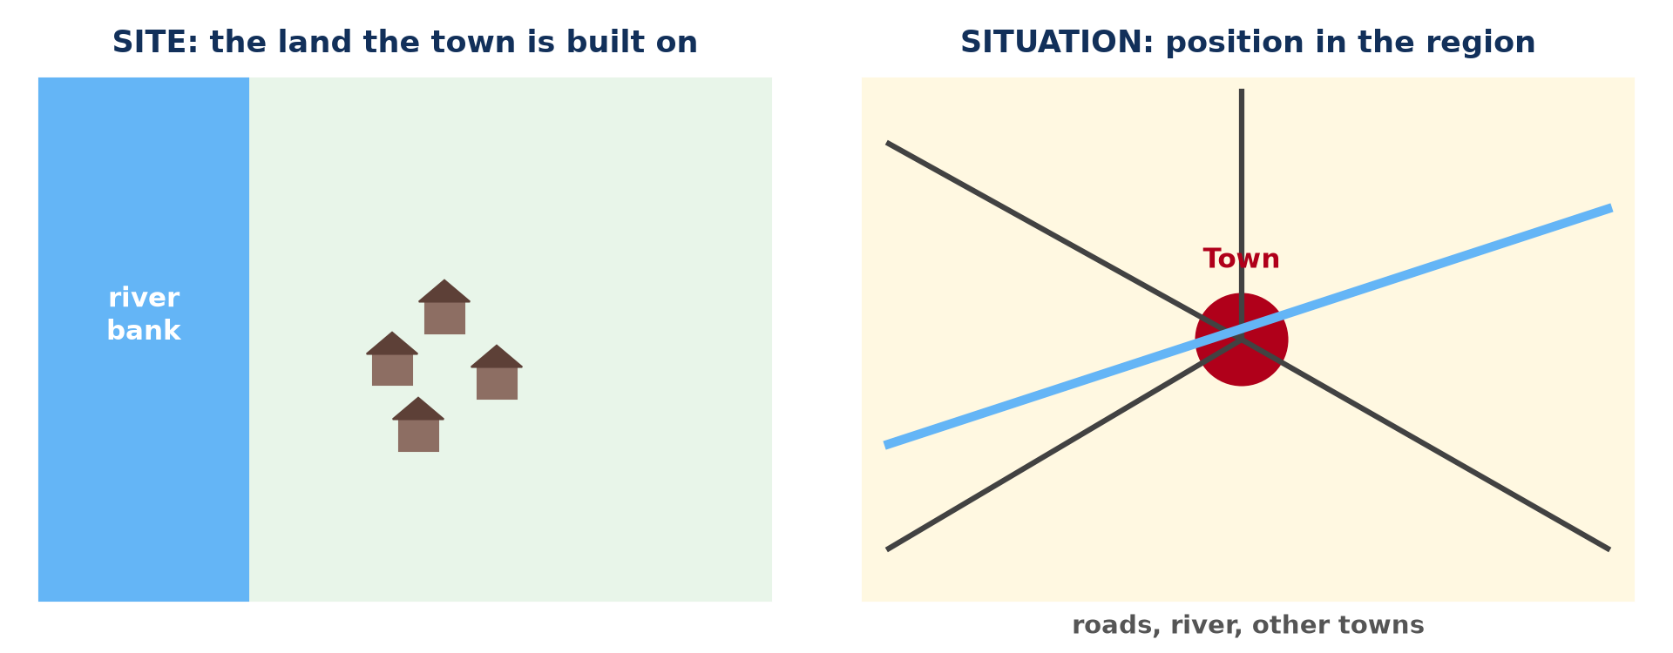
1. SITE AND SITUATION
Activity 1
Site and situation.
Notes:
Activity 1. Look carefully at this diagram: site and situation. Observe every detail before I ask the question.

Slide 20
1. SITE AND SITUATION
Activity 1: Question
What is the difference between site and situation?
Notes:
Here is the question for Activity 1: What is the difference between site and situation? Take one minute to think and write your answer in your rough notebook.

Slide 21
1. SITE AND SITUATION
Activity 1: Answer
Site is the land a town is built on; situation is its position in the region.
Notes:
Let us check the answer together. Site is the land a town is built on; situation is its position in the region.

Slide 22
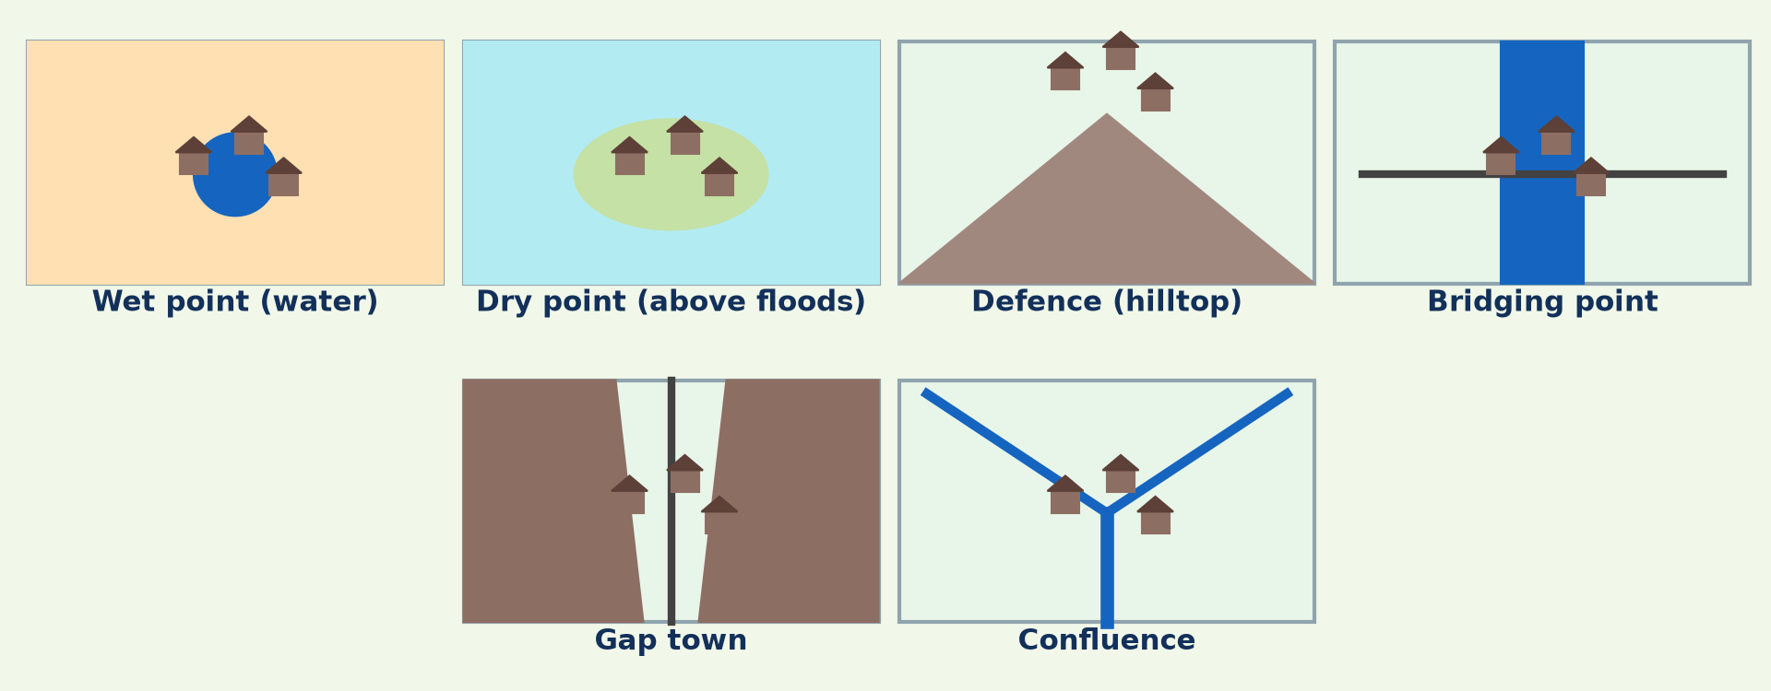
2. TYPES OF SITE
Activity 2
Six types of site.
Notes:
Activity 2. Look carefully at this diagram: six types of site. Observe every detail before I ask the question.

Slide 23
2. TYPES OF SITE
Activity 2: Question
What is a bridging point?
Notes:
Here is the question for Activity 2: What is a bridging point? Take one minute to think and write your answer in your rough notebook.

Slide 24
2. TYPES OF SITE
Activity 2: Answer
A place where a river can be crossed easily.
Notes:
Let us check the answer together. A place where a river can be crossed easily.

Slide 25

2. TYPES OF SITE
Activity 3
Monteriggioni, a walled hilltop town (Italy).
Notes:
Activity 3. Look carefully at this picture: monteriggioni, a walled hilltop town (Italy). Observe every detail before I ask the question.

Slide 26
2. TYPES OF SITE
Activity 3: Question
What type of site is this?
Notes:
Here is the question for Activity 3: What type of site is this? Take one minute to think and write your answer in your rough notebook.

Slide 27
2. TYPES OF SITE
Activity 3: Answer
A defensive (hilltop) site.
Notes:
Let us check the answer together. A defensive (hilltop) site.

Slide 28

3. EXAMPLES OF SITUATION
Activity 4
Douala.
Notes:
Activity 4. Look carefully at this picture: douala. Observe every detail before I ask the question.

Slide 29
3. EXAMPLES OF SITUATION
Activity 4: Question
Why has Douala's situation helped it to grow?
Notes:
Here is the question for Activity 4: Why has Douala's situation helped it to grow? Take one minute to think and write your answer in your rough notebook.

Slide 30
3. EXAMPLES OF SITUATION
Activity 4: Answer
It is a port linked to the interior and neighbouring countries.
Notes:
Let us check the answer together. It is a port linked to the interior and neighbouring countries.

Slide 31

3. EXAMPLES OF SITE
Activity 5
Bamenda in its valley.
Notes:
Activity 5. Look carefully at this picture: bamenda in its valley. Observe every detail before I ask the question.

Slide 32
3. EXAMPLES OF SITE
Activity 5: Question
Describe the site of Bamenda.
Notes:
Here is the question for Activity 5: Describe the site of Bamenda. Take one minute to think and write your answer in your rough notebook.

Slide 33
3. EXAMPLES OF SITE
Activity 5: Answer
In a valley below an escarpment, with streams and fertile soils.
Notes:
Let us check the answer together. In a valley below an escarpment, with streams and fertile soils.

Slide 34
BOARD SUMMARY
Board Summary
Topic: Location of Settlement
Sub-topic: Location of Settlement
Lesson 2: Site and Situation of Settlements
Notes:
Now we are going to copy the board summary. Write the title and the headings neatly in your notebooks. I will give you enough time for each slide, so do not rush.

Slide 35
BOARD SUMMARY
DEFINITIONS
The key terms of this lesson are defined as follows:
Site: It is the actual land on which a settlement is built, with its relief, soil and water.
Notes:
Let us copy the definitions. The key terms of this lesson are defined as follows. On this slide we have Site. Write each point on a new line, with the key term first, and explain it in your own words when we revise. When you finish, we go to the next slide.

Slide 36
BOARD SUMMARY
DEFINITIONS (continued)
Situation: It is the position of a settlement in relation to the surrounding area, routes and other settlements.
Notes:
We continue with the definitions. On this slide we have Situation. Write each point on a new line, with the key term first, and explain it in your own words when we revise.

Slide 37
BOARD SUMMARY
1. Examples of Sites
Common types of sites are:
Wet-point and dry-point sites: Wet-point sites are near water in dry regions, like oasis towns. Dry-point sites are raised above marshes or floods.
Notes:
Let us copy Examples of Sites. Common types of sites are. On this slide we have Wet-point and dry-point sites. Write each point on a new line, with the key term first, and explain it in your own words when we revise. When you finish, we go to the next slide.

Slide 38
BOARD SUMMARY
1. Examples of Sites (continued)
Defensive sites: They are on hills, in river meanders or on islands, like medieval hill towns. They were easy to protect from enemies.
Bridging points and gap towns: Bridging points grow where a river can be crossed. Gap towns grow in valleys through mountains.
Notes:
We continue with Examples of Sites. On this slide we have Defensive sites and Bridging points and gap towns. Write each point on a new line, with the key term first, and explain it in your own words when we revise.

Slide 39
BOARD SUMMARY
1. Examples of Sites
Illustration: types of site
Notes:
Now draw this illustration in your notebook: types of site. Give it a title and label it clearly.

Slide 40
BOARD SUMMARY
2. Examples of Situation
A good situation helps a settlement to grow:
Douala: It is on the Wouri estuary, near the sea, at the start of the railway and roads to the interior. This situation made it the economic capital and main port.
Notes:
Let us copy Examples of Situation. A good situation helps a settlement to grow. On this slide we have Douala. Write each point on a new line, with the key term first, and explain it in your own words when we revise. When you finish, we go to the next slide.

Slide 41
BOARD SUMMARY
2. Examples of Situation (continued)
Bamenda and Yaoundé: Bamenda sits on a plateau below an escarpment at a route centre of the North-West. Yaoundé lies on hills at the centre of the country, a good situation for a capital.
Notes:
We continue with Examples of Situation. On this slide we have Bamenda and Yaoundé. Write each point on a new line, with the key term first, and explain it in your own words when we revise.

Slide 42
BOARD SUMMARY
2. Examples of Situation
Illustration: site and situation
Notes:
Now draw this illustration in your notebook: site and situation. Give it a title and label it clearly.

Slide 43
BOARD SUMMARY
3. Factors of Settlement Site
The choice of a site depends on:
Physical factors: Water supply, relief, drainage, soils and building materials were the main factors. Flood-free, gentle land was preferred.
Notes:
Let us copy Factors of Settlement Site. The choice of a site depends on. On this slide we have Physical factors. Write each point on a new line, with the key term first, and explain it in your own words when we revise. When you finish, we go to the next slide.

Slide 44
BOARD SUMMARY
3. Factors of Settlement Site (continued)
Human factors: Defence, routes, trade and political decisions also mattered. Modern sites depend more on roads, industries and planning.
Notes:
We continue with Factors of Settlement Site. On this slide we have Human factors. Write each point on a new line, with the key term first, and explain it in your own words when we revise.

Slide 45
FORMATIVE EVALUATION
Evaluation 1
Distinguish site and situation.
Notes:
Now let us check what you have understood. Question 1: Distinguish site and situation. Answer in your exercise book.

Slide 46
FORMATIVE EVALUATION
Expected Answer
Site is the land a town is built on; situation is its position relative to its surroundings.
Notes:
The expected answer is: site is the land a town is built on; situation is its position relative to its surroundings. If you got it right, well done.

Slide 47
FORMATIVE EVALUATION
Evaluation 2
Give three types of site.
Notes:
Now let us check what you have understood. Question 2: Give three types of site. Answer in your exercise book.

Slide 48
FORMATIVE EVALUATION
Expected Answer
Wet point, defensive site, bridging point (also dry point, gap, confluence).
Notes:
The expected answer is: wet point, defensive site, bridging point (also dry point, gap, confluence). If you got it right, well done.

Slide 49
REMEDIATION
Remediation
Fill in the blanks:
The land a town is built on is its ______.
A place to cross a river is a ______ point.
A town in a gap between hills is a ______ town.
Notes:
For those who need more practice, fill in the blanks in your exercise book. The answers are: number 1, site; number 2, bridging; number 3, gap.

Slide 50
HOMEWORK
Homework
Describe the site and situation of your town with a sketch.
Notes:
For your homework: Describe the site and situation of your town with a sketch. We shall correct it at the beginning of our next lesson.

Slide 51
NEXT LESSON
Next Lesson
Our next lesson will be on:
Lesson 3: Rural Settlement: Meaning, Types and Size
Notes:
Our next lesson will be on Lesson 3: Rural Settlement: Meaning, Types and Size. Thank you for your attention, and see you next time.

Slide 52
BILINGUAL GAME
Bilingual Game (Jeu Bilingue)
English | Français
Site | Le site
Situation | La situation
Bridge | Le pont
Hilltop | Le sommet
Crossroads | Le carrefour
Estuary | L'estuaire
Notes:
Let us play the bilingual game. I say a word in English, and you give me the French word. Then we do the reverse.

Slide 53
LOGBOOK
Official Logbook (1/2)
Module / Topic | Location of Settlement
Lesson Title | Lesson 2: Site and Situation of Settlements
Expected Learning Outcomes | Distinguish site and situation. Describe the types of settlement site with examples. Explain how situation helps a town to grow.
Competence | Learners are able to describe the site and situation of a settlement.
Notes:
I record this information in the official logbook of the class after the lesson.

Slide 54
LOGBOOK
Official Logbook (2/2)
Matter Taught | DEFINITIONS; Examples of Sites; Examples of Situation; Factors of Settlement Site.
Evaluation | Formative evaluation and remediation exercise.
Homework | Describe the site and situation of your town with a sketch.
Enrolment / Present / Absent | ____ / ____ / ____
Achievement | To be completed after the lesson.
Notes:
I complete the second page of the logbook: the matter taught, the evaluation, the homework and the attendance.

Slide 55
TEACHER'S NOTE
Teacher's Note
Timing: Homework correction, plan, objectives 8 min | Recall, situation, action 10 min | 5 activities 30 min | Board summary (copying) 30 min | Evaluation, remediation 10 min | Homework, next lesson 5 min | Logbook 7 min
Without the projector (Activity 1): draw the two panels.
Without the projector (Activity 2): give examples from Cameroon.
Without the projector (Activity 3): compare with Rhumsiki.
Without the projector (Activity 4): trace routes from Douala.
Without the projector (Activity 5): describe your own town.
Notes:
This slide is for me, the teacher: it gives the timing of the lesson and what to do if the projector is not available.

Slide 56
REFERENCES
References
National Geography Syllabus, MINESEC/IGE/IP-SS, 2019 — Module 5 (Settlement Geography).
Photo, Activity 3: “Piazza Roma, Monteriggioni, Tuscany” by Ray in Manila, CC BY 2.0, via Flickr (https://www.flickr.com/photos/21186555@N07/27053980373)
Photo, Activity 4: “Douala” by christing-O-, CC BY 2.0, via Flickr (https://www.flickr.com/photos/76187282@N00/7227535754)
Photo, Activity 5: “Bamenda, Cameroon” by jbdodane, CC BY-NC 2.0, via Flickr (https://www.flickr.com/photos/27998473@N02/11293877215)
Diagrams and animations: drawn for this lesson (Geography Department).
Notes:
These are the references and picture credits used to prepare this lesson.

